Slide 1

Digital Phenotyping for Early Detection of Student Stress
IEEE CS Bangalore Chapter Internship and Mentorship Program – 2025 (1st April 2025 – 22nd September 2025)
INTN3444 – Internship 2
Lokesh R M
BU22CSEN0100145
Dept of Computer Science & Engineering

Slide 2
Abstract
Our project is about finding better ways to spot stress in students before it gets serious. Instead of relying only on occasional surveys, we built a mobile app that quietly tracks patterns like movement, phone use, and sleep, while also asking students short daily questions through a chatbot. The data is stored securely and analyzed with simple machine learning models to see how it lines up with self-reported stress. In testing, the app showed that changes in behavior, like late-night phone use or reduced activity, often matched higher stress scores. The goal isn’t just to measure stress, but to give students and researchers a tool that’s practical, respectful of privacy, and useful for early support.
Dept of Computer Science & Engineering

Slide 3
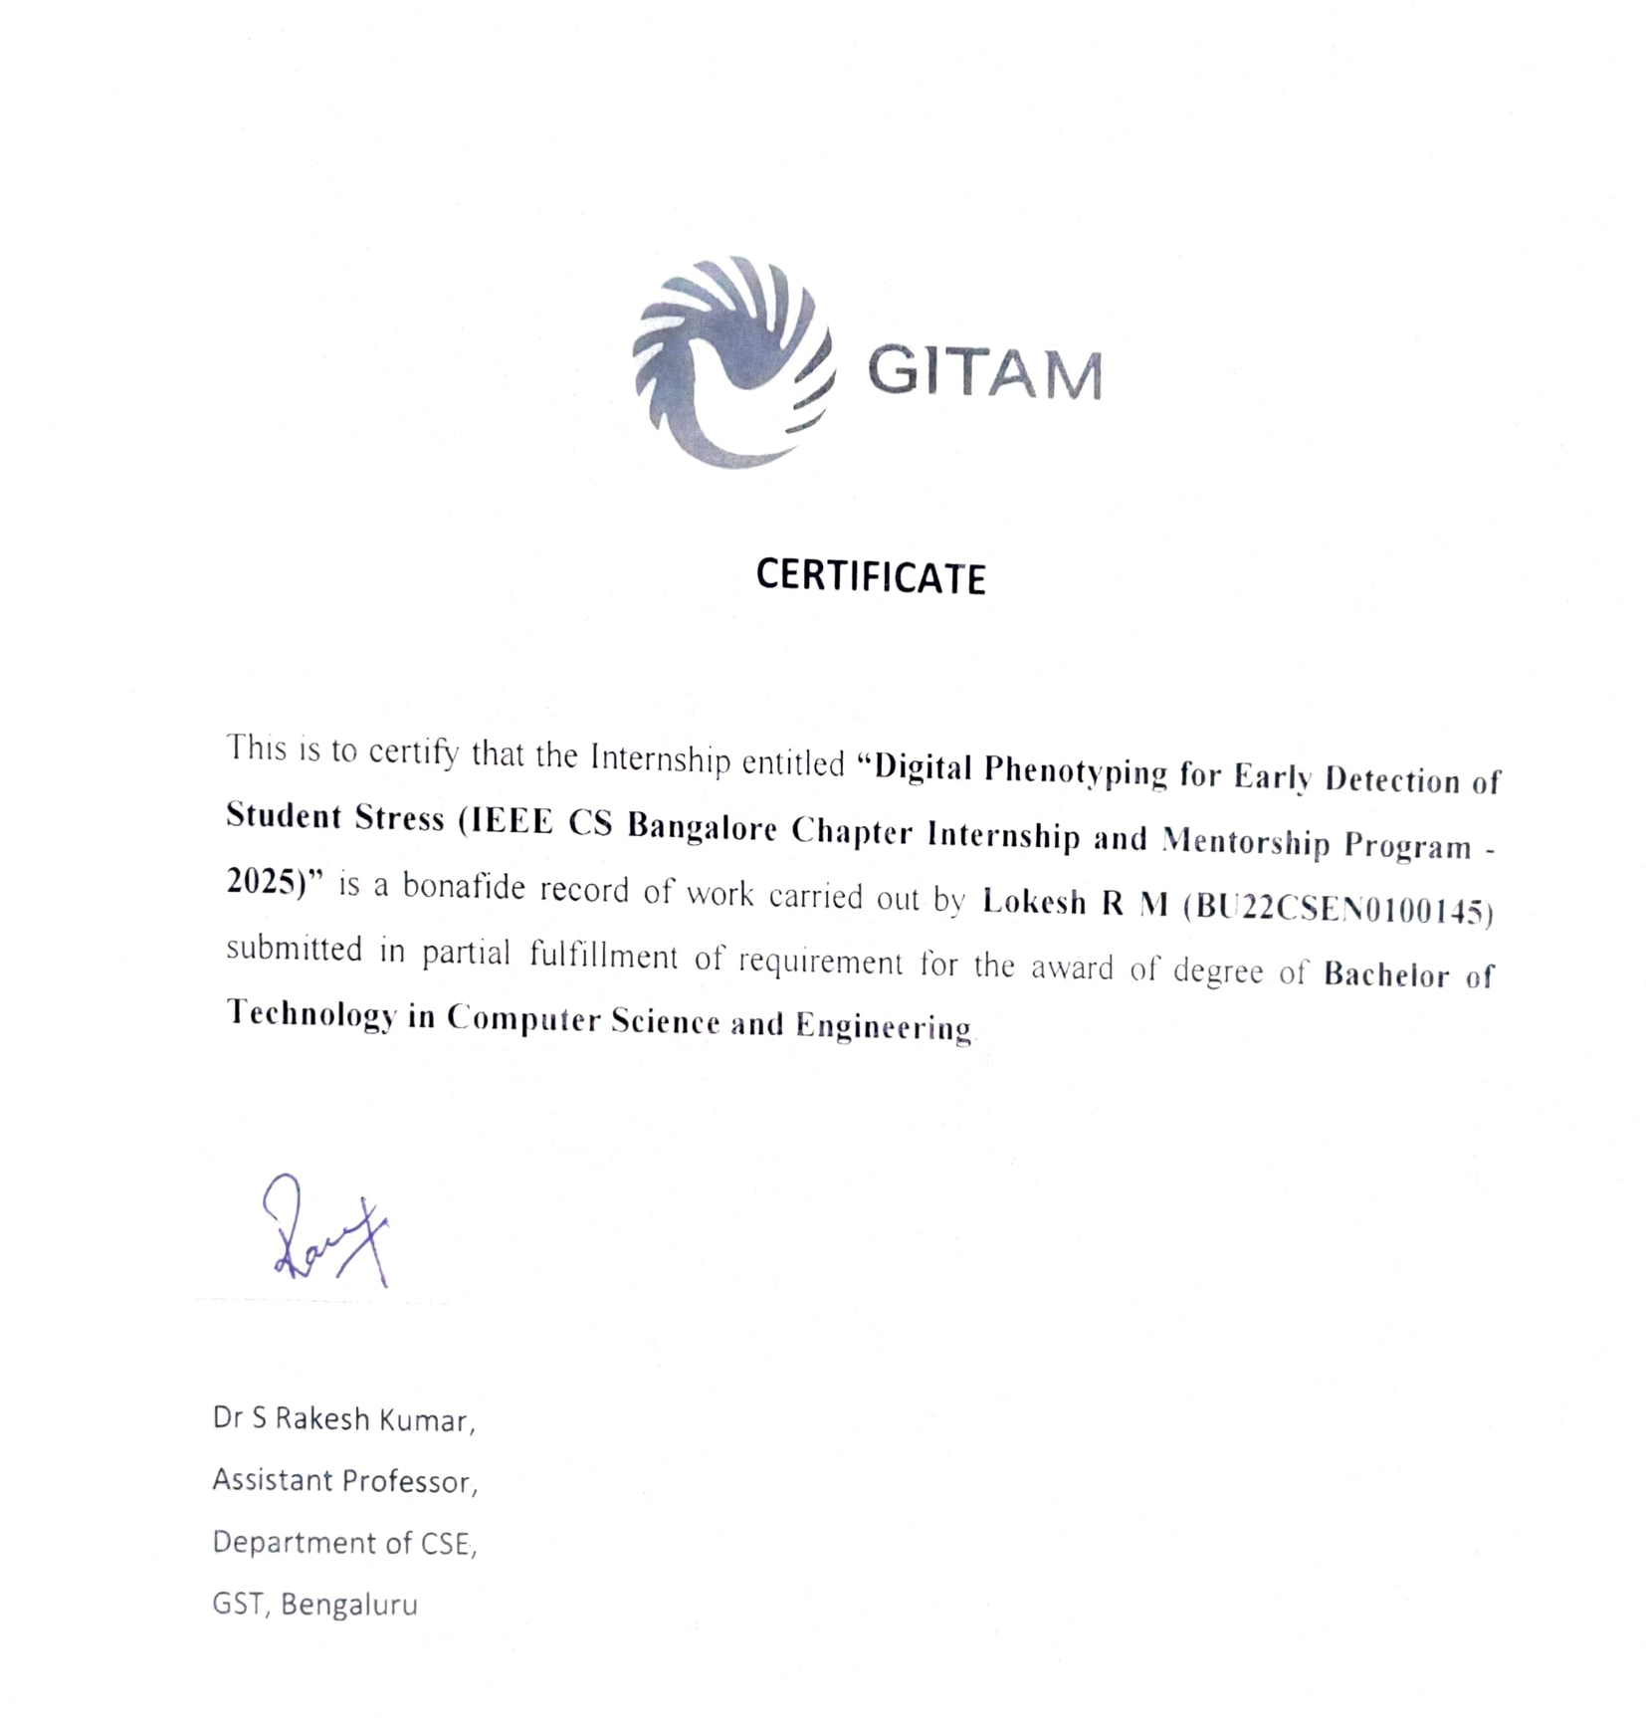
Certificate*
Dept of Computer Science & Engineering

Slide 4
About Internship
This internship was part of the IEEE Computer Society Bangalore Chapter’s Internship and Mentorship Program (2025). It ran from April to September and the format was straightforward: each team had to pick a real-world problem, design a working system around it, and then present the outcome to IEEE at the end.
Our project was titled “Digital Phenotyping for Early Detection of Student Stress”, where we built a mobile app, backend, and machine learning model to track stress patterns in students.
Dept of Computer Science & Engineering
Notes:
https://www.gallup.com/education/509231/college-students-experience-high-levels-worry-stress.aspx
https://www.snhu.edu/about-us/newsroom/education/student-stress
https://transformingeducation.org/student-stress-statistics

Slide 5
Problem Statment
Stress is one of the biggest issues students deal with, but it often goes unnoticed until it’s overwhelming. Studies show that about 75% of college students report feeling stressed, and nearly 1 in 5 struggle with stress-related depression or thoughts of self-harm. The tough part is that most ways of measuring stress — like surveys or counseling sessions — happen only once in a while, so they miss the day-to-day build-up. That gap means early warning signs slip through, and students end up reaching a breaking point before anyone realizes it. Our project looks at how everyday digital signals, like phone use or sleep patterns, can help catch stress earlier and give students a chance to manage it before it gets worse.
Dept of Computer Science & Engineering
Notes:
https://www.gallup.com/education/509231/college-students-experience-high-levels-worry-stress.aspx
https://www.snhu.edu/about-us/newsroom/education/student-stress
https://transformingeducation.org/student-stress-statistics

Slide 6
Project Goals & Objectives
The main goal of our project is simple: to catch student stress early, before it builds up into something harmful. To do that, we set out to build a mobile app that can keep track of both passive signals (like movement, phone use, and sleep patterns)
and
active inputs (short daily check-ins through a chatbot).
By combining these two, the app can spot patterns that line up with rising stress levels.
Dept of Computer Science & Engineering

Slide 7
Project Goals & Objectives
Our specific objectives were:
Build a working mobile app that students can actually use day-to-day.
Collect and process data securely from phones and wearables without invading privacy.
Use machine learning to make sense of that data and give useful stress predictions.
Test the system with real students to see if the predictions match how stressed they actually feel.
Create something practical that could eventually help students manage stress, not just measure it.
Dept of Computer Science & Engineering

Slide 8
Why We Chose This Project
We chose this project because stress is something every student can relate to — including us. Traditional ways of measuring stress, like long surveys or occasional counseling sessions, miss the everyday ups and downs. At the same time, nearly all students carry a smartphone, which means we already have a powerful tool for tracking behavior patterns. That made us ask: why not use the devices we already carry to understand stress better?
Dept of Computer Science & Engineering

Slide 9
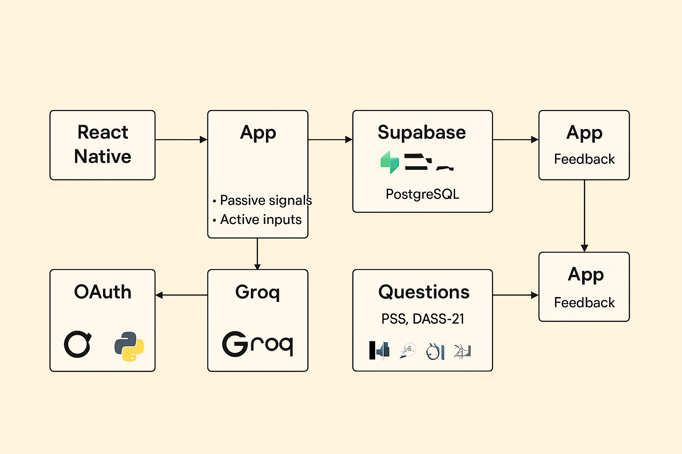
Proposed System
Mobile App (Frontend):
Developed in React Native to ensure cross-platform compatibility (Android + iOS).
It collects two types of data:
Passive signals – movement (accelerometer), GPS, app usage, screen time, and wearable integration.
Active signals – daily mood check-ins and short survey questions presented through a chatbot.
Backend (Database + APIs):
We used Supabase for authentication, database management, and secure data storage.
Database:
Supabase (PostgreSQL) stores structured data such as survey responses, sensor logs, and stress prediction results.
Authentication:
OAuth 2.0 allows safe login and wearable integrations
Dept of Computer Science & Engineering

Slide 10
Proposed System
Machine Learning (Analytics Layer):
Data is processed into features like daily activity level, mobility patterns, and late-night phone usage.
We used an SVM (Support Vector Machine) model to classify stress vs. no-stress states.
AI Layer (Optional Features):
We explored Groq-based AI models to make the chatbot more interactive and to suggest personalized tips for stress management.
Survey Design:
The questions are based on validated stress measurement scales such as PSS (Perceived Stress Scale) and DASS-21. This helps in aligning our data with established psychological benchmarks.
System Flow:
User logs in via OAuth → app starts tracking passive signals.
Chatbot prompts user with short daily questions.
Data flows into Supabase (PostgreSQL).
Features are extracted → SVM model predicts stress level.
App shows simple feedback + optional AI-driven suggestions.
Admin dashboard allows cohort-level monitoring and export for research.
Dept of Computer Science & Engineering

Slide 11
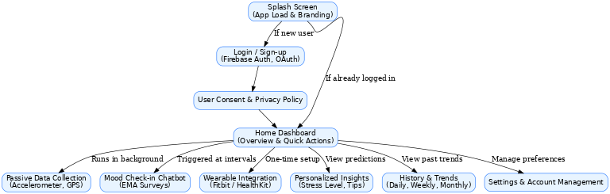
Proposed System
Dept of Computer Science & Engineering

Slide 12
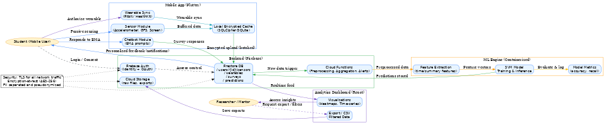
Proposed System
Dept of Computer Science & Engineering

Slide 13
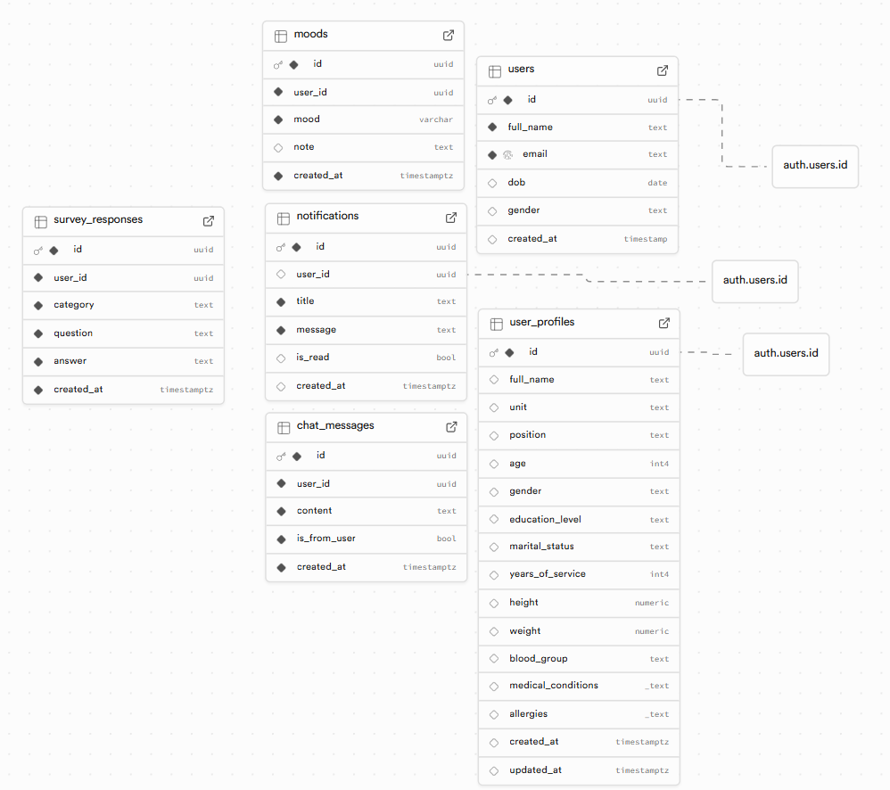
Proposed System
Dept of Computer Science & Engineering

Slide 14
Key Features
Hybrid data collection – The app doesn’t just rely on surveys. It combines passive signals like phone activity, movement, and location with active inputs like daily chatbot check-ins.
Wearable integration – Students can link devices like Fitbit or HealthKit to track sleep, steps, and heart rate.
Smart chatbot – A simple, conversational chatbot asks stress-related questions (based on PSS and DASS-21 scales) and makes the process less boring.
Machine learning stress prediction – Data is processed through an SVM model to predict stress levels, giving students timely feedback.
Feedback and tips – The app provides students with easy-to-read results and small suggestions for managing stress.
Privacy and security – Data is stored in Supabase (PostgreSQL), with OAuth authentication for secure logins and control over wearable connections.
AI enhancement – We tested Groq AI to make feedback smarter and more personalized.
Dept of Computer Science & Engineering

Slide 15
Key Highlights & Learnings
Built the mobile app in React Native, so it runs on both Android and iOS.
Used Supabase for the backend, handling both database storage and API access.
Trained and tested our SVM model using scikit-learn, with analysis and graphs made in matplotlib and pandas.
Developed everything inside VS Code, with Git for version control.
Ran pilot tests with students:
App retention stayed close to 88–90%.
Sensor data collection was >90% complete.
Predictions showed a strong match with self-reported stress.
Discovered clear patterns: late-night phone activity and reduced movement often matched higher stress levels.
Dept of Computer Science & Engineering

Slide 16
Conclusion
Through this project, we showed that it’s possible to use everyday digital signals — like movement, phone use, and sleep — along with short daily check-ins to spot stress in students early. Our mobile app, backed by Supabase and powered by an SVM model, was able to capture reliable data and give predictions that lined up well with self-reported stress levels. The pilot results confirmed that students were willing to use the app regularly, and that patterns like late-night phone activity or reduced movement really do connect with higher stress.
Overall, the system worked as intended: it gave us a practical, privacy-conscious way to track stress in real time. While there’s still room to grow — like improving accuracy, expanding wearable support, and making feedback more personalized — this project proves that digital phenotyping can be a valuable tool for student well-being.
Dept of Computer Science & Engineering

Slide 17
Thank You
Dept of Computer Science & Engineering

